Slide 1
Random Forest

Slide 2
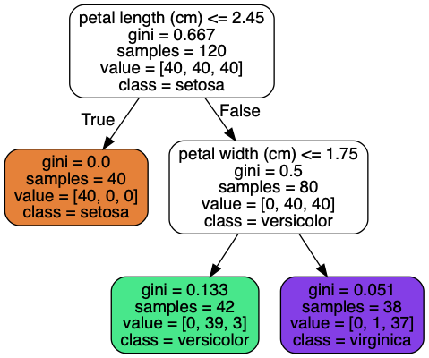
Random Forests
Collection (ensemble) of many decision trees
  Each casts their vote, majority wins
Trained with bootstrapping/bagging
  Sampling with replacement, training size (usually) remains same as original
  Tree diversity
Notes:
Photo: https://www.flickr.com/photos/107442568@N08/12547327134

Slide 3
Random Forests
Collection (ensemble) of many decision trees
  Each casts their vote, majority wins
Trained with bootstrapping/bagging
One of the best estimators available
Notes:
Photo: https://www.flickr.com/photos/107442568@N08/12547327134

Slide 4
Random Forest Parameters
Same as decisions trees + …
Number of estimators
Bootstrap
Max samples (when bootstrapping)
Out of bag scoring
  Different from validation, each tree has its oob samples and samples are not evaluated across full RF
  Quick to estimate generalization
Notes:
For out of bag scoring, each tree has some samples that were left out of the bag, so each tree individually canbe scored on those and the performance can be aggregated across the many trees. However, this is different from validation since vaildation will score each sample across all the trees, which is also what will happen in practice

